Slide 1
SAP EWM EXTENDED WAREHOUSE MANAGEMENT TRAINING
AnubhavTrainings.com
www.anubhavtrainings.com

Slide 2

SAP EWM TRAINING
BY:-
Mr. Bijoy
www.anubhavtrainings.com
Notes:
https://unsplash.com/photos/uXB-7la5vqA

Slide 3
SAP EWM TRAINING (Day 14)
AnubhavTrainings.com

Slide 4
POSC (Process Oriented Storage control)
Concept & Business scenario for POSC
Understanding complex Putaway process in SAP EWM
Configuration related to POSC
Externals steps, Storage process, Destination Bin determination
Testing of Complex putaway process

Slide 5
EWM Exception Codes
The exception code basically describes an Exception situation in the warehouse. This Exception situation occurs, for example, if data that the system returns does not match up with the actual situation in the warehouse. You can use a short form of the exception to communicate this to the system.
Example -
While doing Put away WT confirmation, Destination bin is not available for put away due to bin damage/bin renovation so in this case we can use Exception code “CHBD” to change the destination bin

Slide 6
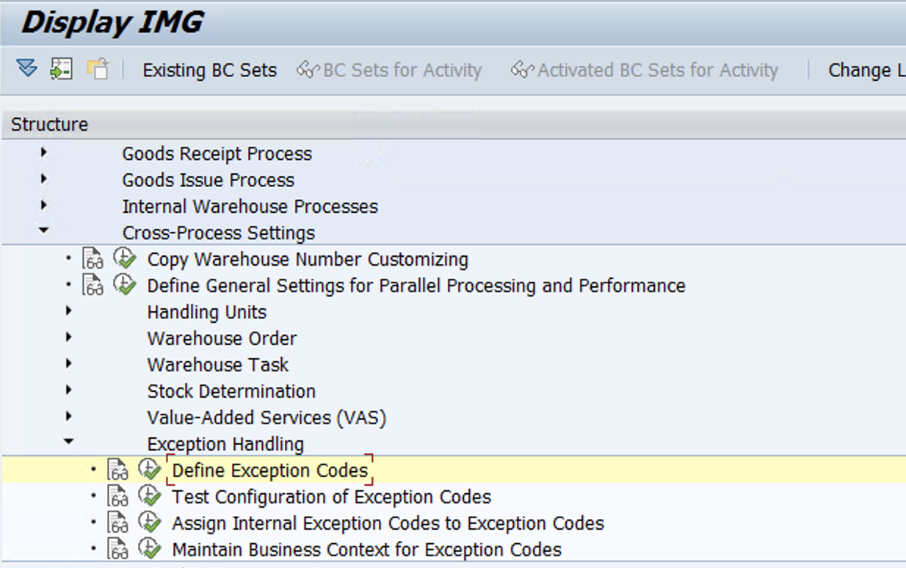
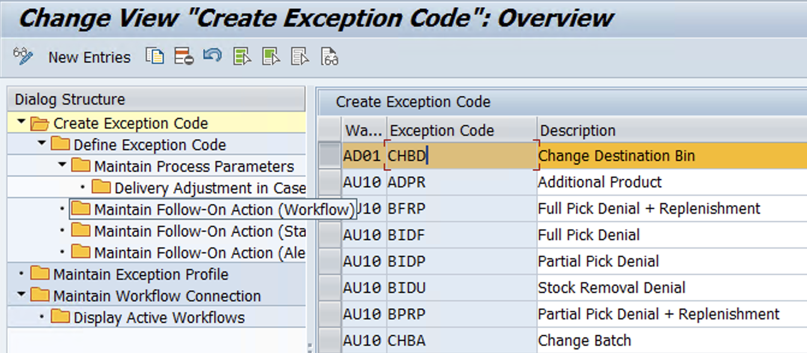
Configuration
Define Exception code

Slide 7
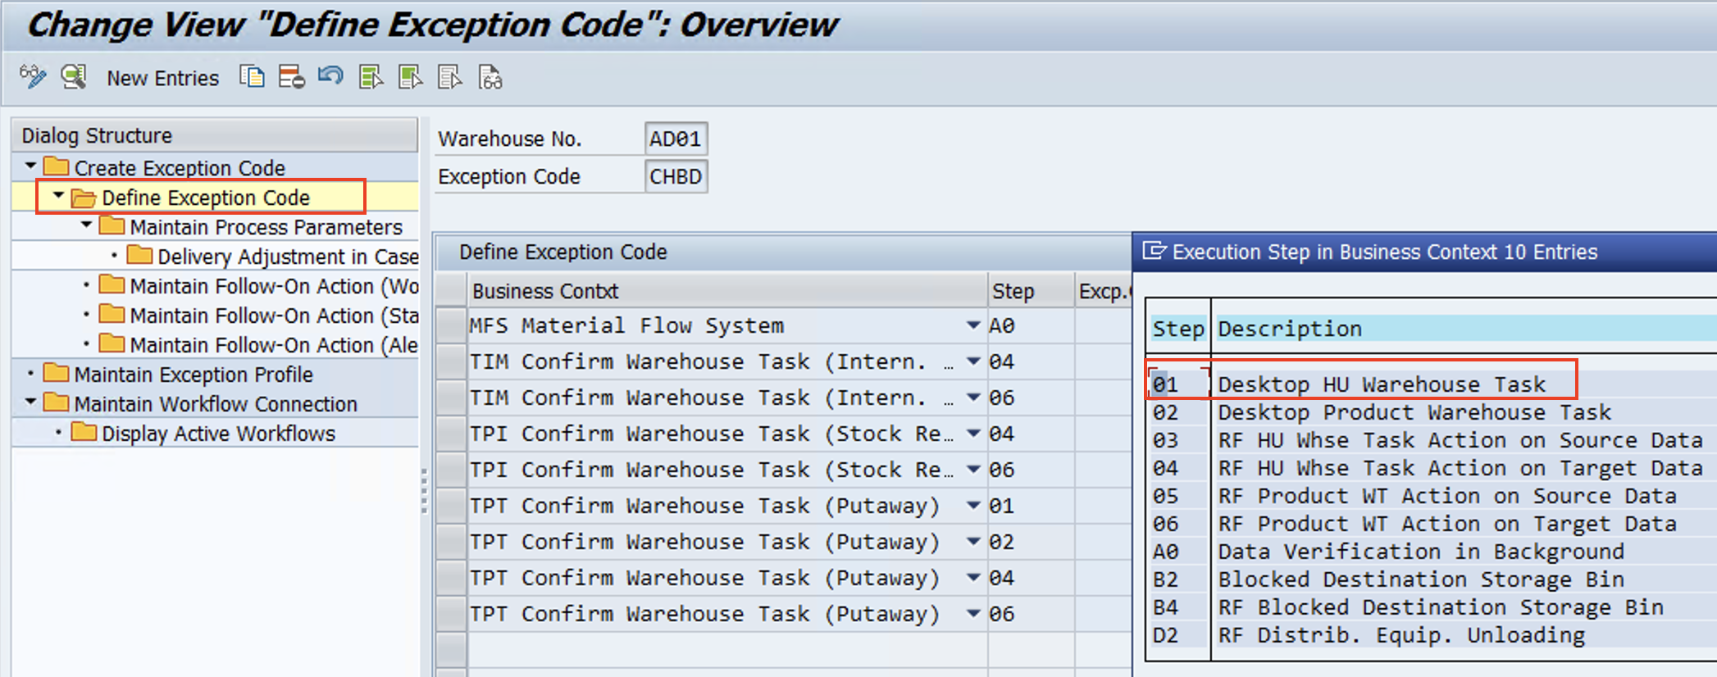
New Entries in Create Exception code > Then go step by step as shown in left side flow ….

Slide 8
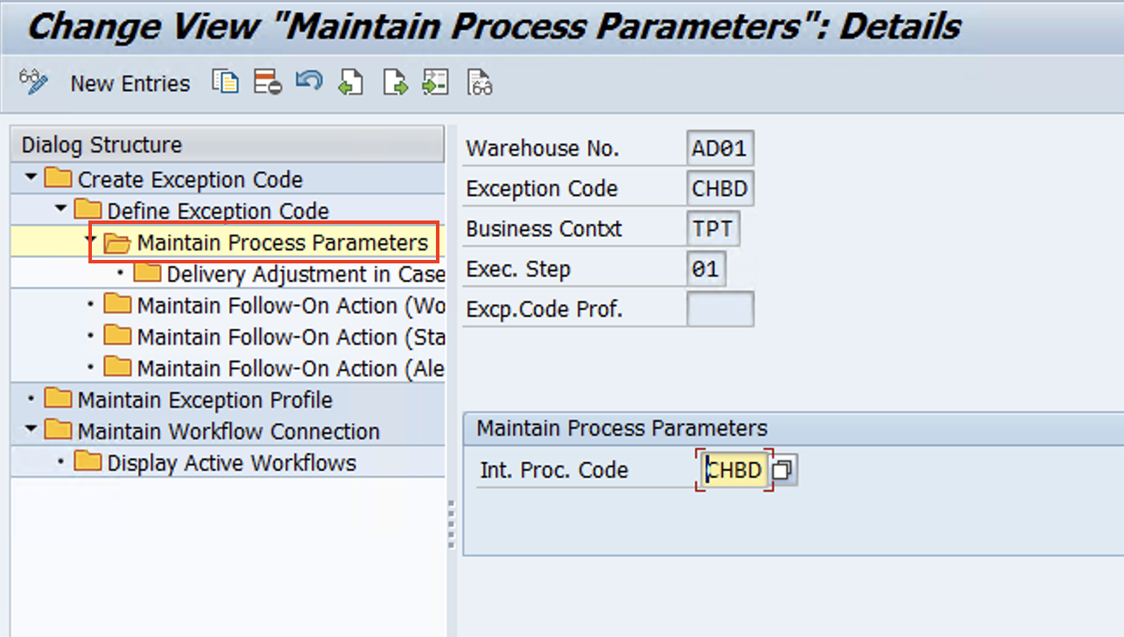
www.anubhavtrainings.com

Slide 9
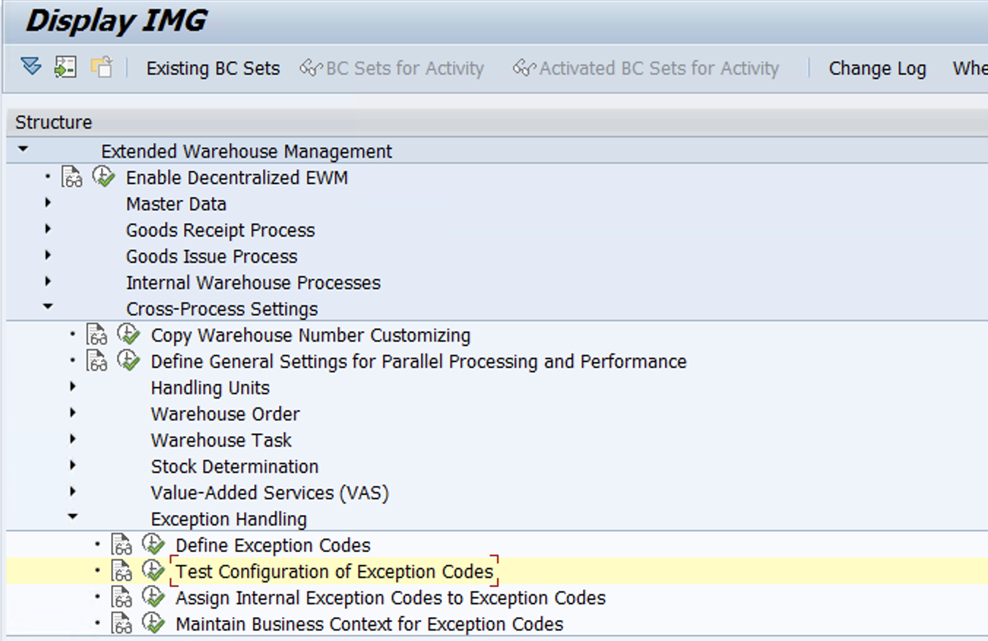
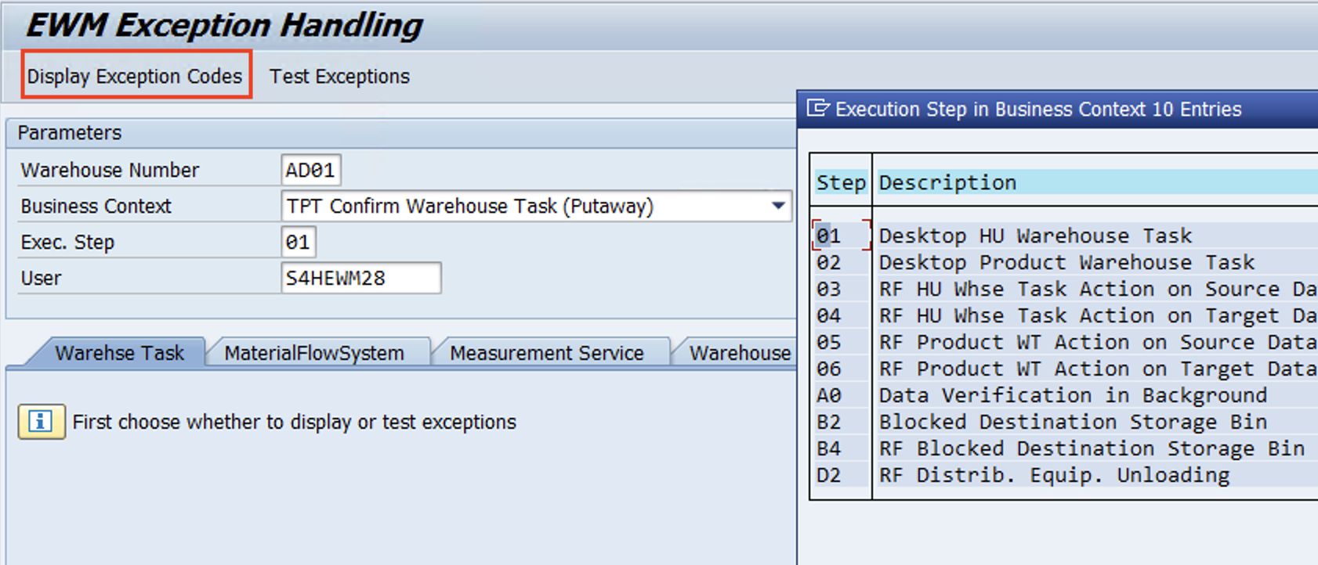
Test Configuration of Exception codes
www.anubhavtrainings.com

Slide 10
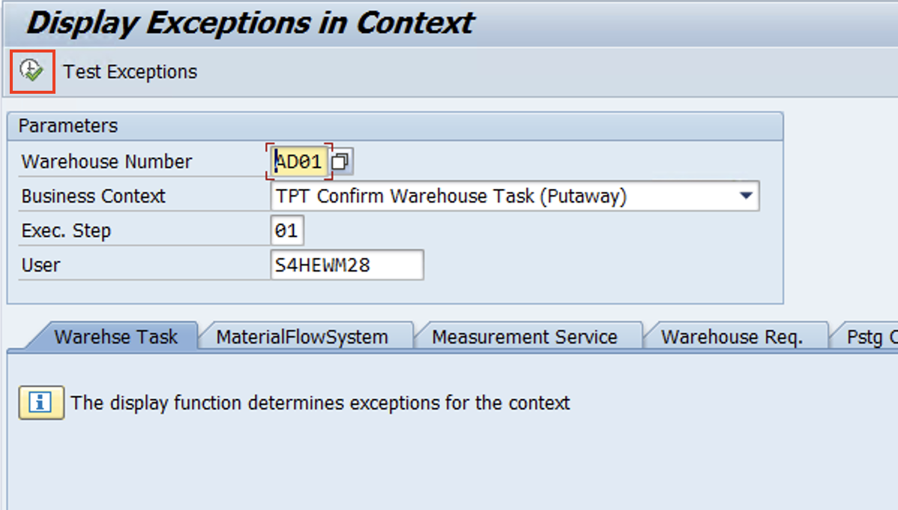

Slide 11
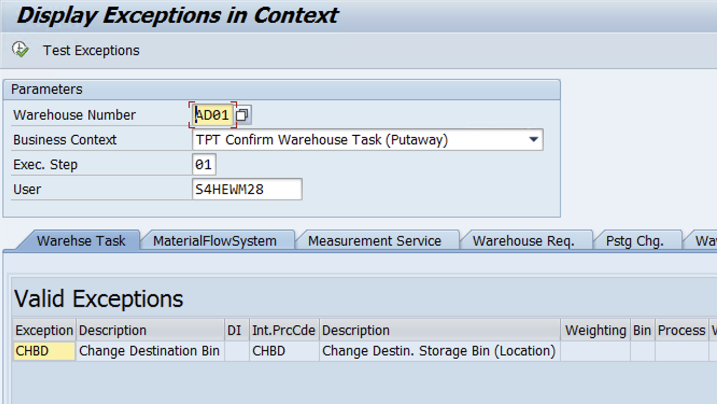
System should show Exception codes as shown in below pic.

Slide 12
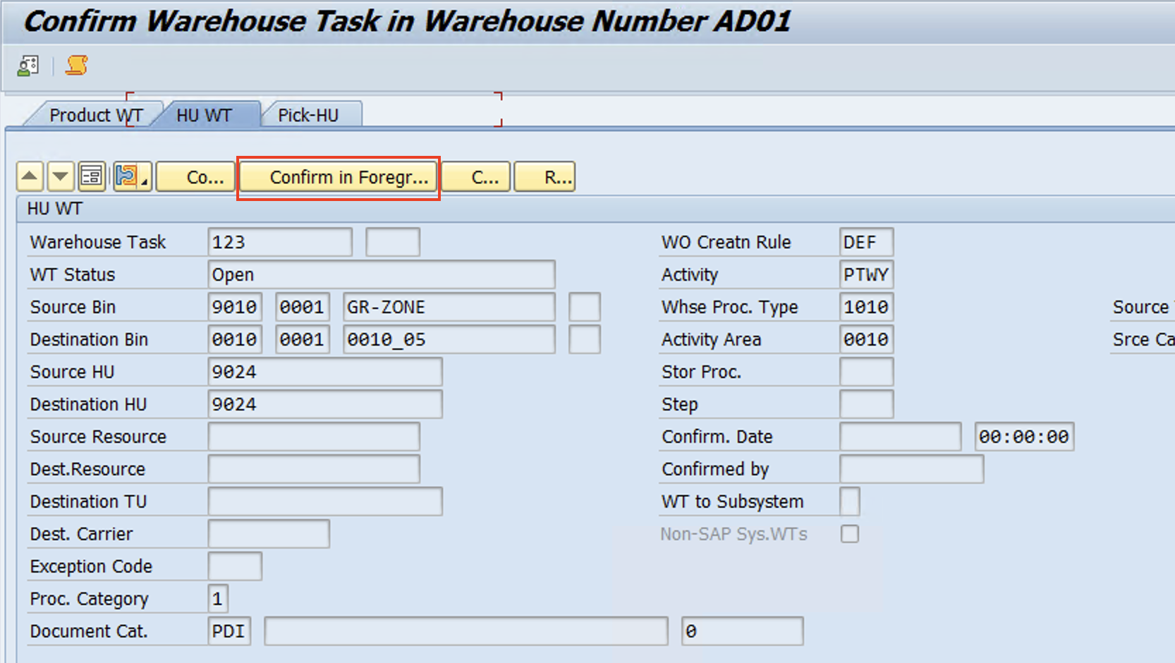
Test Case
Create Putaway WT >> Confirm in foreground

Slide 13
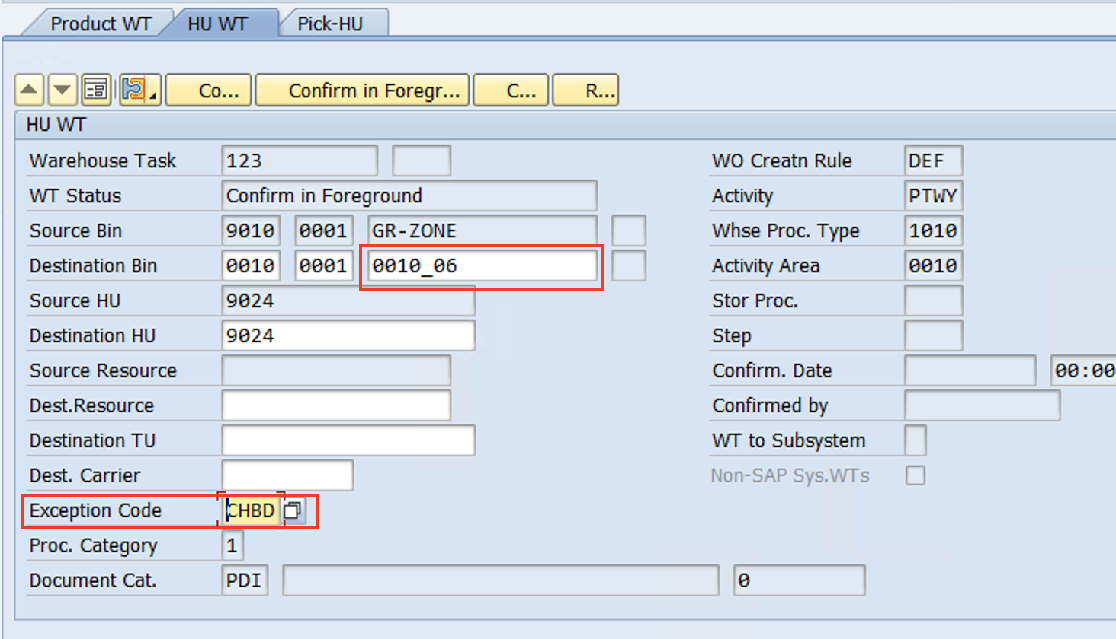
Change the destination Bin & Enter exception code - CHBD
Confirm the WT.
It's Done!
www.anubhavtrainings.com

Slide 14


End of Session 14
www.anubhavtrainings.com

Slide 15

FEEL FREE TO ASK QUESTIONS

Slide 16

Feedback

Slide 17
THANK
YOU

Slide 18




More from AnubhavTrainings.com

Slide 19






We’re committed to empower you to be
#FutureReady
through powerful training solutions.
We build the workforce of the future.
250+
Corporate Clients
30,000+
Learners Trained
25000+
Learners Placed
FREE WEBINARS
Sign up for free webinars with industry experts every fortnight!
Enroll Now!

Slide 20
FREE WEBINARS
Sign up for free webinars with industry experts every fortnight!
Contact us today!
www.anubhavtrainings.com

